Slide 1
Tracheotomy
Dr.Alaa A. Ibrahim

Slide 2
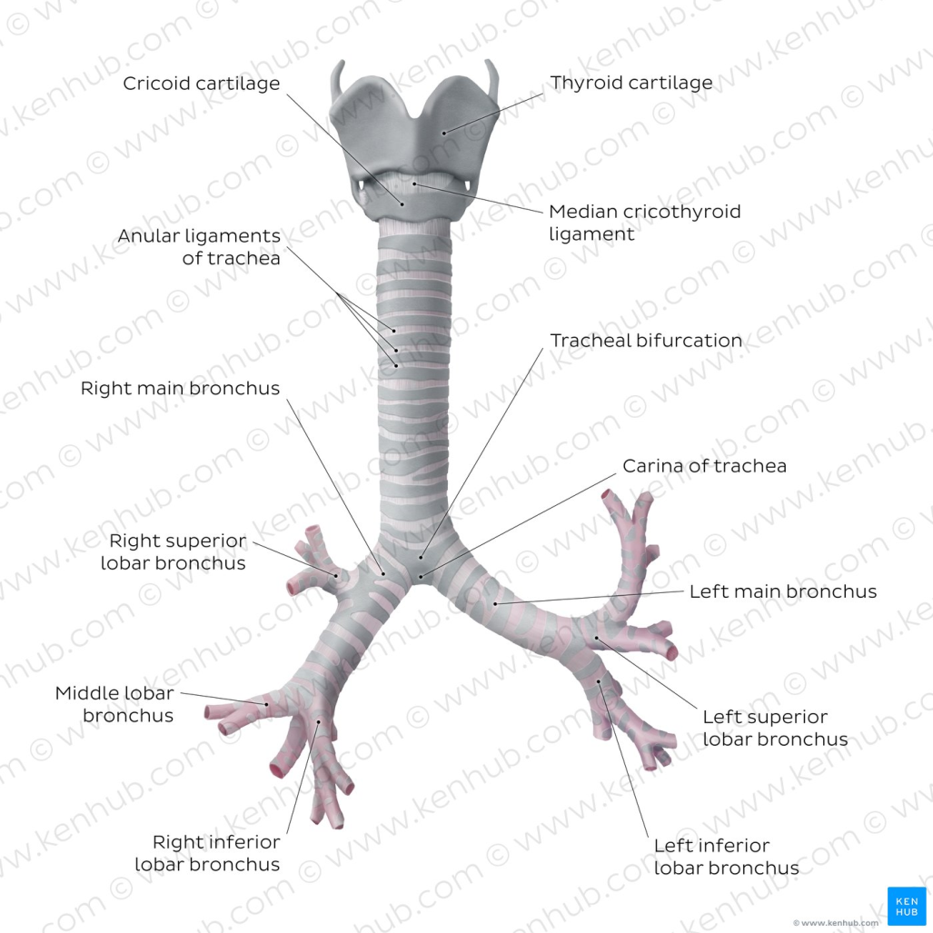
Anatomy
Trachea extends from the cricoid cartilage of the larynx to the base of the heart, where it terminates at the carina
At this point, the trachea bifurcates into the principal (mainstem) bronchi, one to each hemithorax.
These then split into lobar bronchi, one of which supplies each anatomic lung lobe

Slide 3
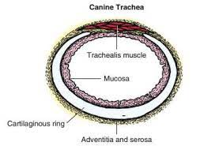
The trachea consists of incomplete hyaline cartilage rings, which are connected dorsally by the trachealis muscle
The cartilage arches serve to exert outward pressure against the trachealis muscle, thereby maintaining the tracheal lumen
Approximately 35 rings are present, and a range of up to 46 has been reported
Between the rings of the trachea are bands of fibroelastic tissue known as the annular ligaments, which are continuous
with the perichondrium(سمحاق الغضروف)
supporting soft tissue structures allow remarkable
shape and length accommodation of the more rigid
tracheal rings.

Slide 4
Tracheal wall in cross-section consists of an inner mucosa and submucosa followed by a fibrocartilaginous ring and outer adventitia in the cervical trachea or serosa in the intrathoracic
The trachea receives a segmental blood supply from the cranial and caudal thyroid arteries
The main innervation of the tracheal mucosa and trachealis muscle is from the right vagus and recurrent laryngeal nerve

Slide 5
Tracheotomy
Indication
Tracheotomy is performed to gain access to the tracheal lumen to remove obstructions
Collect specimens
Facilitate airflow
The tracheal incision may be closed or allowed to heal by secondary intention. Position the patient as described

Slide 6
Surgical technique
Approach the cervical trachea through a ventral cervical midline incision. Extend the incision from the larynx to the sternum as needed to allow adequate exposure.
Separate the sternohyoid muscles along their midline, and retract them laterally.

Slide 7
Dissect the peritracheal connective tissue from the ventral surface of the trachea at the proposed tracheotomy site.
Take care to prevent traumatizing the recurrent laryngeal nerves, carotid artery, vagosympathetic trunk, jugular vein, thyroid vessels, or esophagus. Immobilize the trachea between the thumb and the forefinger
Make horizontal or vertical incision
through the wall of the trachea

Slide 8
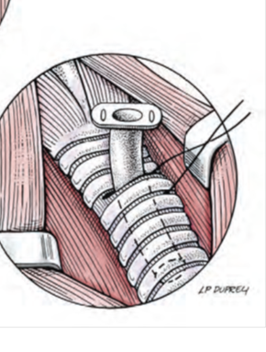
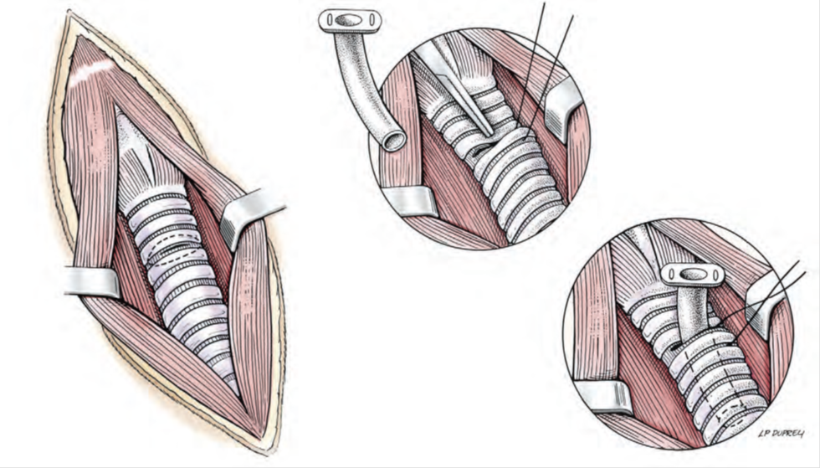
Place cartilage-encircling sutures (2-0 polypropylene [Prolene] or polybutester [Novafil]) around adjacent cartilages to separate the edges and allow lumen inspection or tube insertion.
Suction blood, secretions, and debris from the tracheal lumen
After completion of the procedure, appose the tracheal edges with simple interrupted 3-0 or 4-0 polypropylene sutures

Slide 9
Appose the sternohyoid muscles in a simple continuous pattern with 3-0 or 4-0 absorbable suture.
Appose the subcutaneous tissues and skin routinely.
To close the tracheal incision, place sutures through the annular ligaments encircling adjacent cartilages or through the annular ligaments only.
Lavage the surgical site with saline

